Slide 1
Abstract Automata Learning
Kudos to various sources for sharing their slides

Slide 2
Reminder

Slide 3
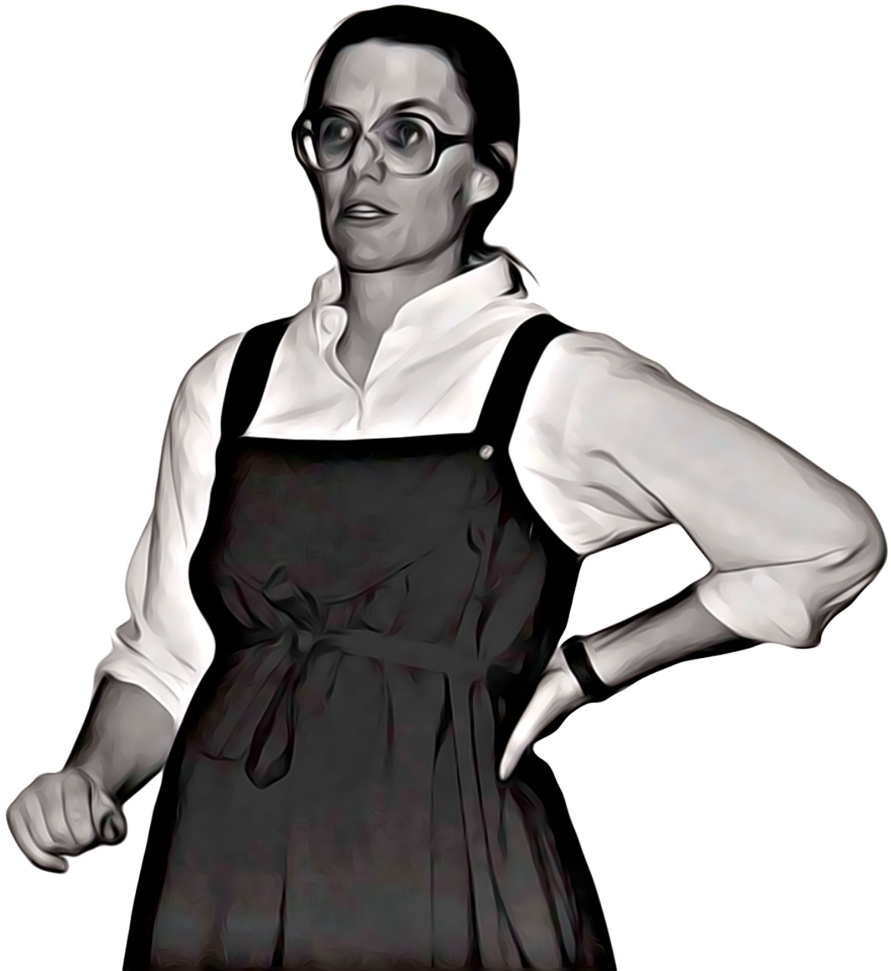
Active Learning

Slide 4

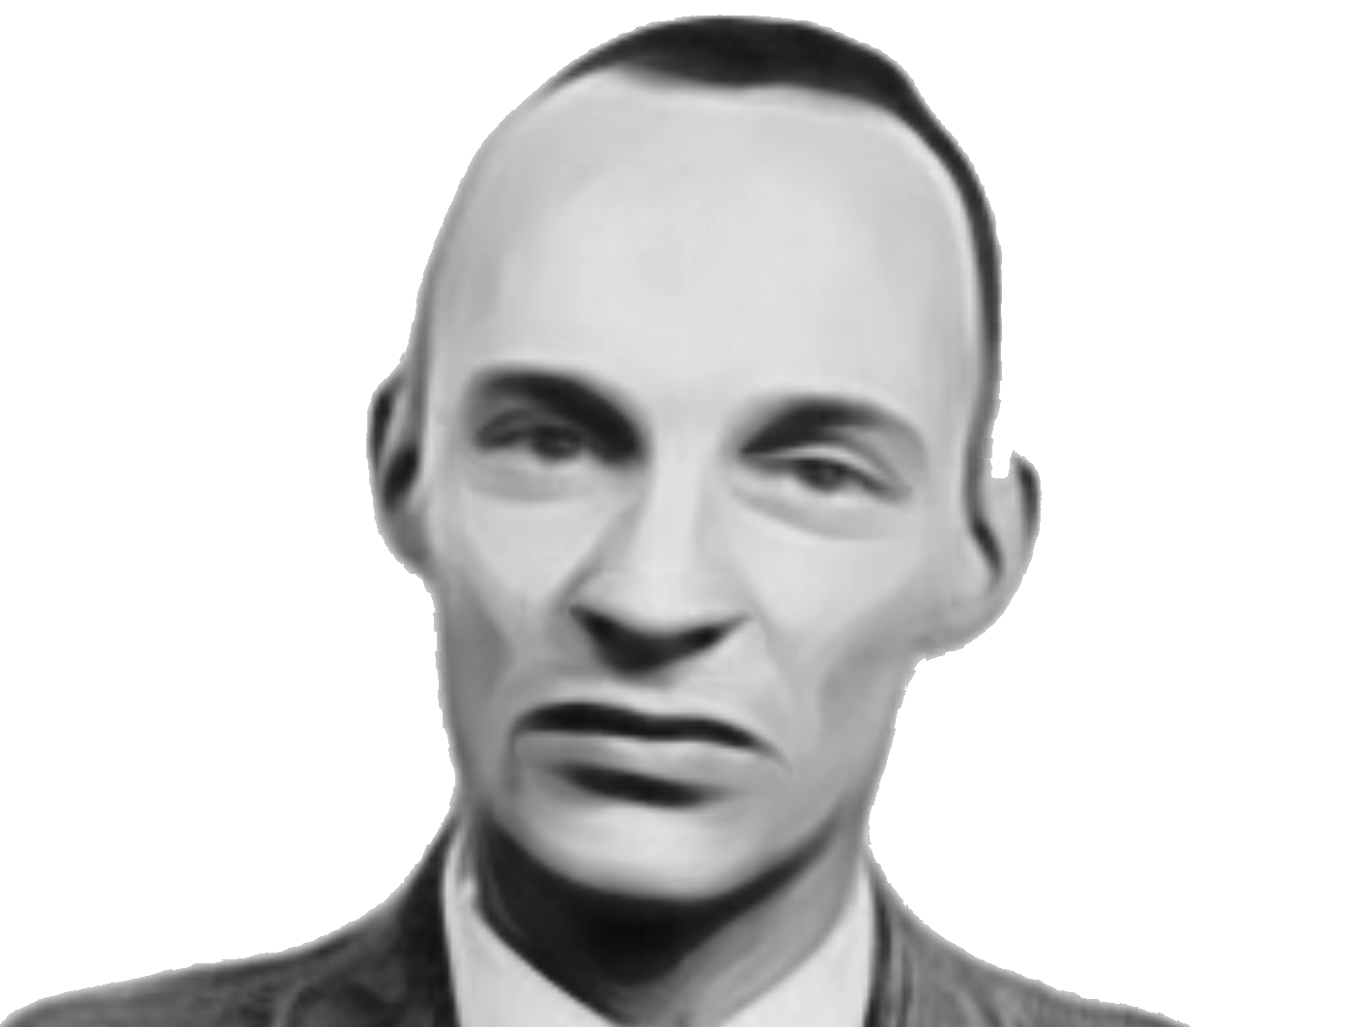
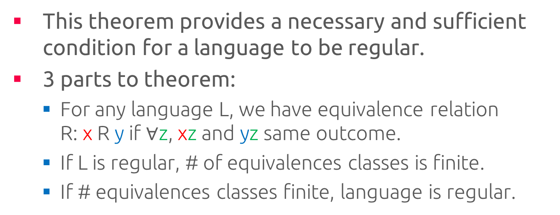
Myhill-Nerode Theorem
This theorem provides a necessary and sufficient condition for a language to be regular.
3 parts to theorem:
For any language L, we have equivalence relation R: x R y if $∀$z, xz and yz same outcome.
If L is regular, # of equivalences classes is finite.
If # equivalences classes finite, language is regular.

Slide 5
Abstract Automata Learning in Action

Slide 6


Abstract Automata Learning

Slide 7



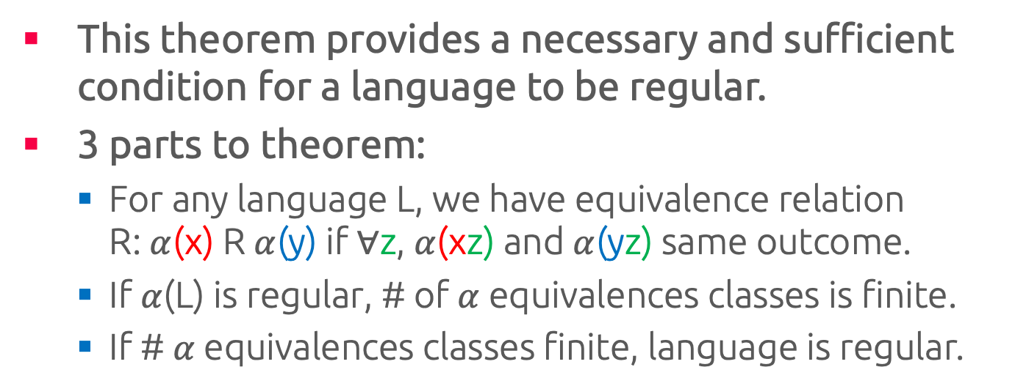

Myhill-Nerode Theorem for Abstraction $α$
This theorem provides a necessary and sufficient condition for a language to be regular.
3 parts to theorem:
For any language L, we have equivalence relation R: $α$(x) R $α$(y) if $∀$z, $α$(xz) and $α$(yz) same outcome.
If $α$(L) is regular, # of $α$ equivalences classes is finite.
If # $α$equivalences classes finite, language is regular.

Slide 8
Abstract Automata Learning

Slide 9
Learning with Abstraction
SUL works with concrete alphabets
Automata works with abstract alphabets
Mapper knows about abstraction & concretization
Abstract Input
Concrete Input
Learner
Mapper
SUL
Abstract Output / CEX
Concrete Output / CEX
Howar 11, Aarts 15

Slide 10
Counterexamples
A hypothesis includes abstract behaviors so far.
Now, what do counterexamples tell us?
A behavior that is not observed so far.
A mistake in the abstraction.
Wrong abstraction?
What do counterexamples tell us?
There is a more precise abstraction!

Slide 11
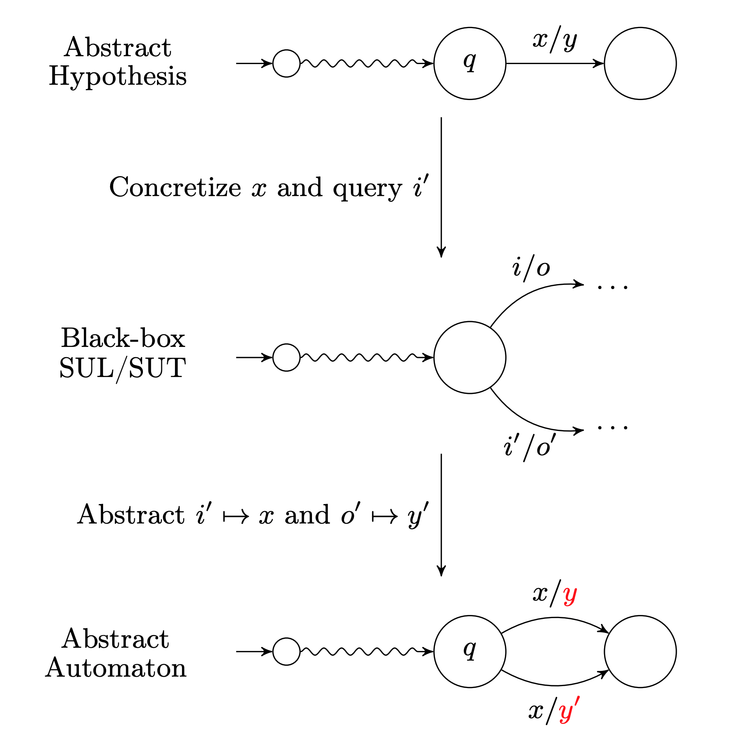
Counterexamples for Abstraction

Slide 12

Abstraction Refinement
Input refinement:
Split into $x$ and $x′$
Output refinement:
Merge $y$ and $y′$

Slide 13
Divergent
Caused by wrong abstraction
Always a new concrete output for some concrete input
Cannot form a closed table
Always exists a counterexample

Slide 14
Example 1

Slide 15
Example 1^{contd.}

Slide 16
Example 1^{contd.}

